Slide 1

Machine Translation (Romanian to Romani translation)
Zibileanu Sabin (512)
Grigore Dragoș - Gabriel (512)
Vasilescu Costin – Tiberiu (507)
Handac Alexandru - Radu (507)

Slide 2
TABLE OF CONTENTS
1. Introduction
2. Data acquisition
3. Approach + Results
4. Limitations
5. Conclusions
6. Bibliographic references

Slide 3

INTRODUCTORY NOTES

Slide 4
A gentle start
We present the steps and the tools necessary to build machine translation deep learning models for Romanian to Romani. Even though it is a low - resource language, the Romani language is a very popular one around the world.
This presentation covers modern deep learning approaches that can be a building block for future research on this language.

Slide 5
Data acquistion

Slide 6
DATA ACQUISITION
The data was obtained from different sources, those being:
- Glosbe
- Romani courses
- Romani conversational guides
- Romani dictionaries
- Dataset from HelsinkiNLP

Slide 7
HOW DID YOU BUILD THE CORPUS??
Working with a low-resource language we took into account the fact that we had to build a corpus from scratch almost. however, we found a corpus online with around 7900 samples from Romanian to Romani from HelsinkiNLP which to our knowledge is in the Carpathian Romani dialect.
To add more data, we scraped samples from Glosbe as it provided Carpathian Romani samples translated into Romanian.
Next on, we manually gathered a set of samples from different dictionaries, conversational guides, and a Romani course support.

Slide 8
APPROACH AND RESULTS

Slide 9
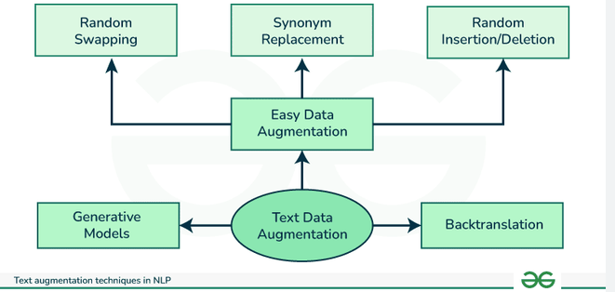
DATA AUGMENTATION
We felt that it was necessary to try and use some data augmentation techniques, especially working with a low resource language. The techniques that we used were:
Back translation
Sentence insertion
Random character insertion
The augmentation was done on 15% of the dataset.
Source : GeeksForGeeks

Slide 10
APPROACH
Our approach was divided as follows:
-Training a MarianMT model initially with custom and extended tokenizers and afterwards with the base ones.
-Fine-tuning a NLLB-200 model to evaluate performance on a model designed for multilingual tasks.
-Fine-tuning Llama-3.2-3B for generative translation to analyze its capabilities on this task.

Slide 11
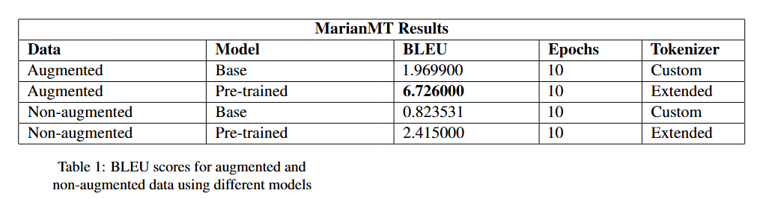
RESULTS
Somewhat expected results, especially for a low resource language and a relatively small corpus. What can we notice is that the pre-trained model with the extended tokenizer might be the way to go.

Slide 12
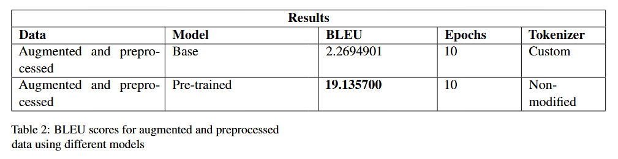
RESULTS
Furtherly ehanching our experiments with different environments, those being: using the custom created tokenizer with the base model and with the removal of the diacritics for the Romani data and using the already existent tokenizer for the pre-trained model with no additional changes and the removal of the diacritics for the Romani data.

Slide 13
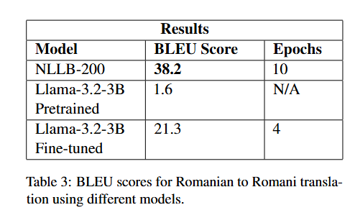
RESULTS
What is very interesting to notice here is that Llama-3.2-3B has minimal knowledge of the Romani language achieving a BLEU score of 1.6 without any fine – tuning. The NLLB model seems to have the best performance achieving a really good BLEU score.

Slide 14
LIMITATIONS

Slide 15
LIMITATIONS
The most notable limitation that can be seen is the quality of the results. This is caused by the low amount of data that was gathered. In order to build a high - standard machine translation model for Romanian to Romani, a large corpus is needed first (millions of sentences) that can be verified by a Romani speaker. It can be built from books, dictionaries, conversational guides and even songs why not.
Additionally, fine-tuning a large model like Llama requires significant computational resources, making experimentation more challenging.

Slide 16
CONCLUSIONS

Slide 17
CONCLUSIONS
Although the results were far from perfect, the project covered modern approaches to tackling a difficult machine translation problem presenting all the steps and tools that were used, and as a result becoming a building block for future projects and research aimed at the Romani language.
We liked this project because it allowed us to build something from the ground up and learn more about machine translation in the process. We believe that this project will surely leave room for improvement for the future and is a starting point for this task.

Slide 18
BIBLIOGRAPHIC RESOURCES
https://www.academia.edu/43726447/Ghid_de_conversa%C5%A3ie_Rom%C3%A2n_Romano_Rum%C3%AEnisko_Romano_Lumini%C5%A3a_Mihai_Cioab%C4%83
https://ikultura.ro/wp-content/uploads/2019/09/Suport-De-Curs-Limba-Romani.pdf
https://cdn.prod.website-files.com/601e5c899b255f2ab1aa7bd3/618532c3aee2d5be11a853f5_Romanes-with-Rahela-5.pdf
https://huggingface.co/docs/transformers/model_doc/marian
https://huggingface.co/docs/transformers/model_doc/nllb
https://huggingface.co/docs/transformers/model_doc/llama

